Slide 1
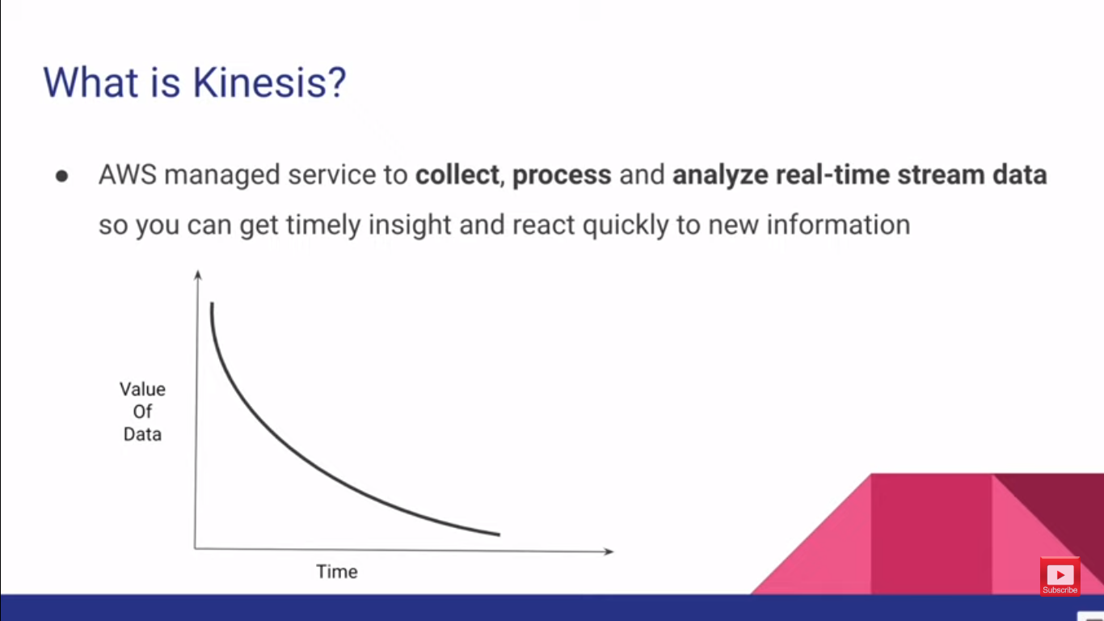
Notes:
this Amazon keynesis service so what is Amazon Kinesis service
now Amazon Kinesis is an AWS manage offering to collect process and analyze
data in real time now this data is essentially stream data
so what is stream data by the way now essentially streaming data means the data that is generated continuously and
this data size are usually small but however there could be Exceptions there
could be large data events as well but in general streaming data is continuously generated data usually they
are of small size so keynesis service can collect this continuously generated
data and it can process them in real time and analyze them in real time and
then you get the timely Insight now this type of stream processing is really important for a business
now let me give an example now imagine that you have lost your credit card or your debit card
so the person who stole it will start buying stuff from various places
or maybe he will go to ATM to ATM and withdraw cash try to drain your account
now let's assume your bank has a system that analyzed this real-time events from
these ATMs or transaction events in real time and it can process these events and
identify any fraudulent activities so in this imaginary case your banking system
identified that there's a fluid activities happening in your account it will inform you immediately
so you can take actions accordingly or else the banking system could itself may be disable the card and then let it
inform you because it's very time critical right because that person could get all the
money in your bank account really quickly so you have to act immediately the banking system has to act immediately so that's where the
real-time stream processing really comes in handy now imagine if your bank only process the data the ATM data and the
ATM data event so these transactions events only at the night as a batch
process so in that case at the time the bank identified there has been some Freedom activities happen in your bank
account then it's too late so that's why the value of the data is
really high SN when they arrived so this graph it shows that now here in
the y axis is the value of data and on the x axis it's the arrival time of that
data so when the data is just arrived the business value of that data can be
very high and when the time goes on the value of the data also goes down
so that's why it's really important to analyze data in real time and get timely inside so you can react to this
information very quickly now in AWS Cloud the service that allows you to do this real-time processing is
kinesis okay

Slide 2
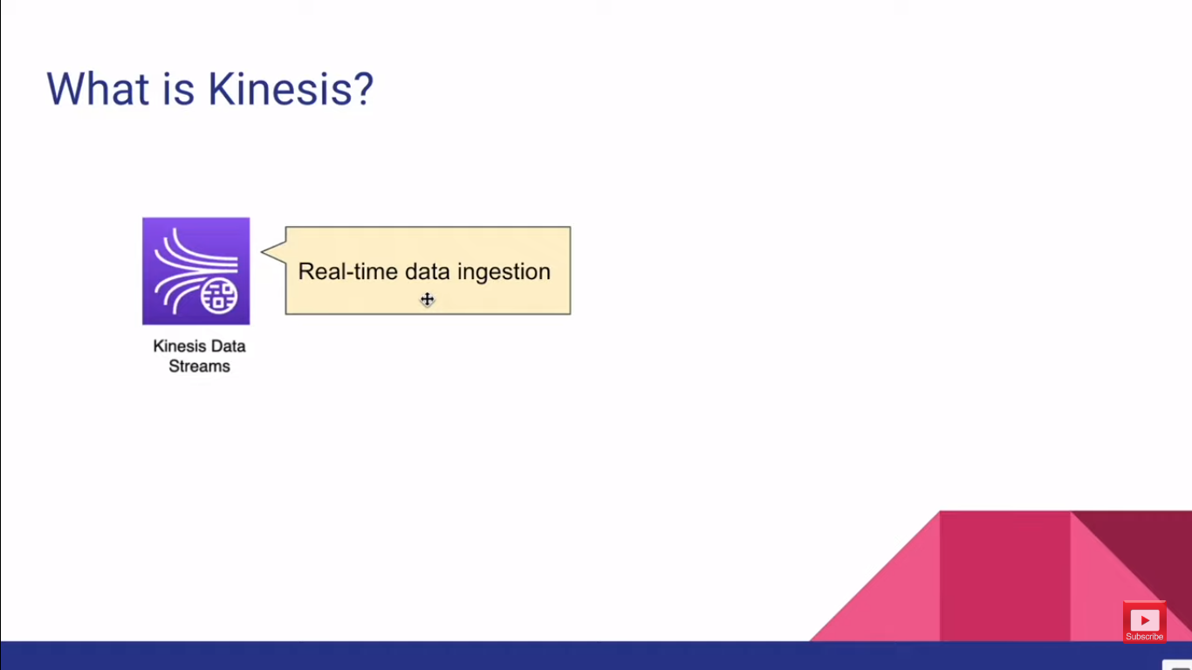
Notes:
now let's have a look at all the Services Under This Kinesis family
now the first service is kinesis data stream now for short we call it KDs
kinesi data stream is essentially used to ingest real-time data at scale
so you can create a Kinesis data stream that can ingest data at high throughput
or high volume of data you do that by increasing the shared counts of a
keynesis data stream now we are going to learn more about charts in upcoming slides but in general a data stream
Kinesis data stream is consists of shards so if you add more shot it can
ingest more data and there are two modes to it on demand mode and provision mode in on
demand mode the short count will be automatically managed for you in provision mode you have to decide how
many shots do you need for your Kinesis data stream but the most important thing that you should remember is that this Kinesis
data stream is not a serverless service meaning that regardless you are using
the on demand mode or the provision mode you either have to pay for the stream hours or The Shard of us plus the data
that you're ingesting we'll talk about that in detail when you are talking about shards but in high level kinesi
data stream is allow you to ingest data in real time

Slide 3
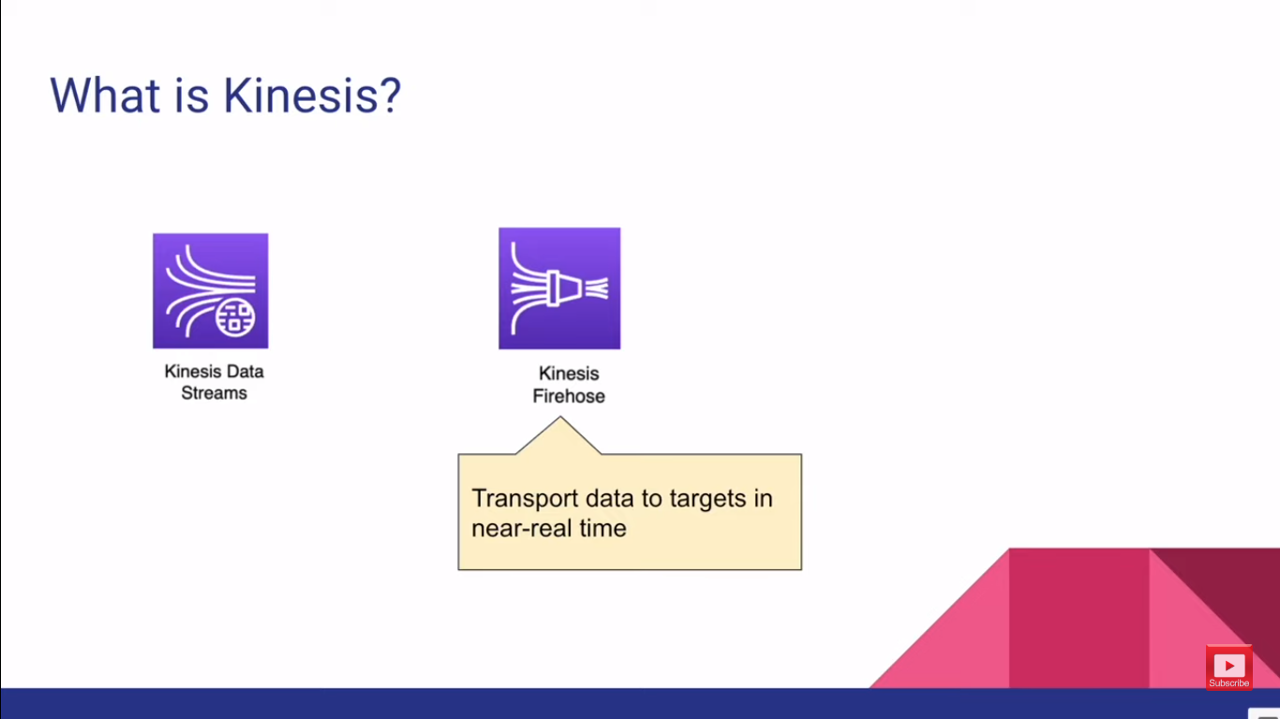
Notes:
next we have kinesis
firehorse now Kinesis fire hose is essentially used to transport this stream of data to
different targets now it can transport data to multiple targets such as Amazon S3 bucket elasticsearch cluster Amazon
redshift for data warehousing or any other HTTP endpoints as well now when
you're transporting this data to targets through Kinesis firehose you can batch them
you can batch this data by time you can say you know batch the data in
every 5 minute or three minute two minutes or 60 seconds and then send the
batch to the Target or else you can batch this data by the data volume you
can say batch when it accumulates one megabyte of data batch the data by one
megabyte chunks however this time-wise batching and the volume wise patching
goes together so Kinesis fire hose look at both of these values and Patch the data by
whatever the threshold it hits first it could be time or it could be the volume now the most important thing about
Kinesis fire hose is that this is a truly a serverless service
so what do I mean by serverless it means if you are not processing data through firehose you're not being charged but
there's another thing that you should remember that Kinesis firehose is not real-time data processing it's near
real-time data processing unlike in Kinesis data streams which can process data in milliseconds Kinesis firehose
can only process data after a minimum of one minute or 60 seconds all right

Slide 4
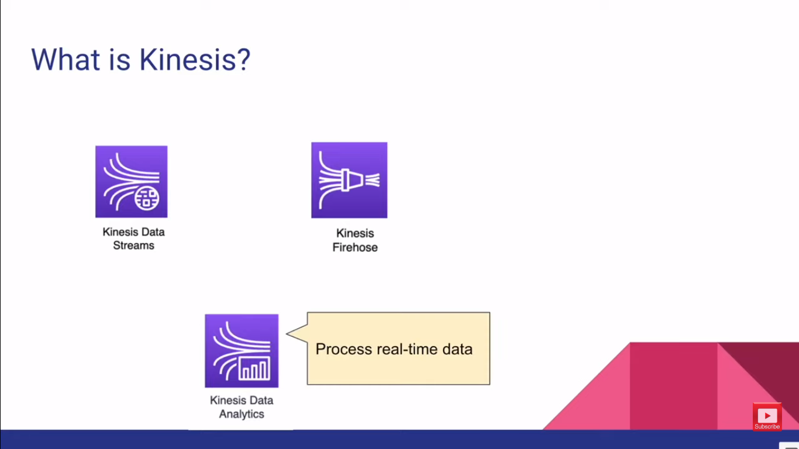
Notes:
so let's look at the next
service which is kinesis data analytics now kinesi data analytics is essentially
used to process the stream data in real time now it can work both with the
Kinesis data stream and kinesis firehose you can connect Kinesis data analytics
to process the data in Kinesis data streams and fire host very easily and
when you are pressing the data with Kinesis data analytics you can use a language similar to SQL or SQL and in
addition to that there are a bunch of SQL template or SQL templates available for you that you can directly use to
process those data in real time all right

Slide 5
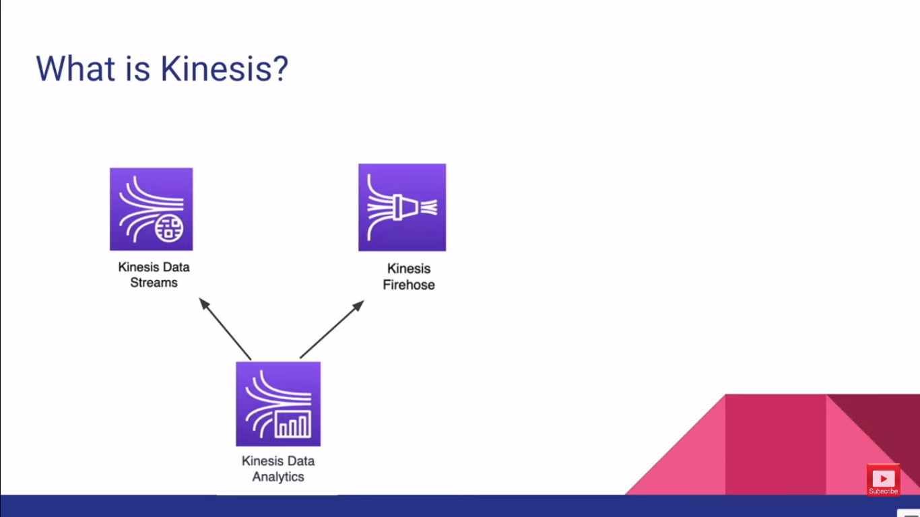
Notes:
so let's look at the next
service which is kinesis data analytics now kinesi data analytics is essentially
used to process the stream data in real time now it can work both with the
Kinesis data stream and kinesis firehose you can connect Kinesis data analytics
to process the data in Kinesis data streams and fire host very easily and
when you are pressing the data with Kinesis data analytics you can use a language similar to SQL or SQL and in
addition to that there are a bunch of SQL template or SQL templates available for you that you can directly use to
process those data in real time all right

Slide 6
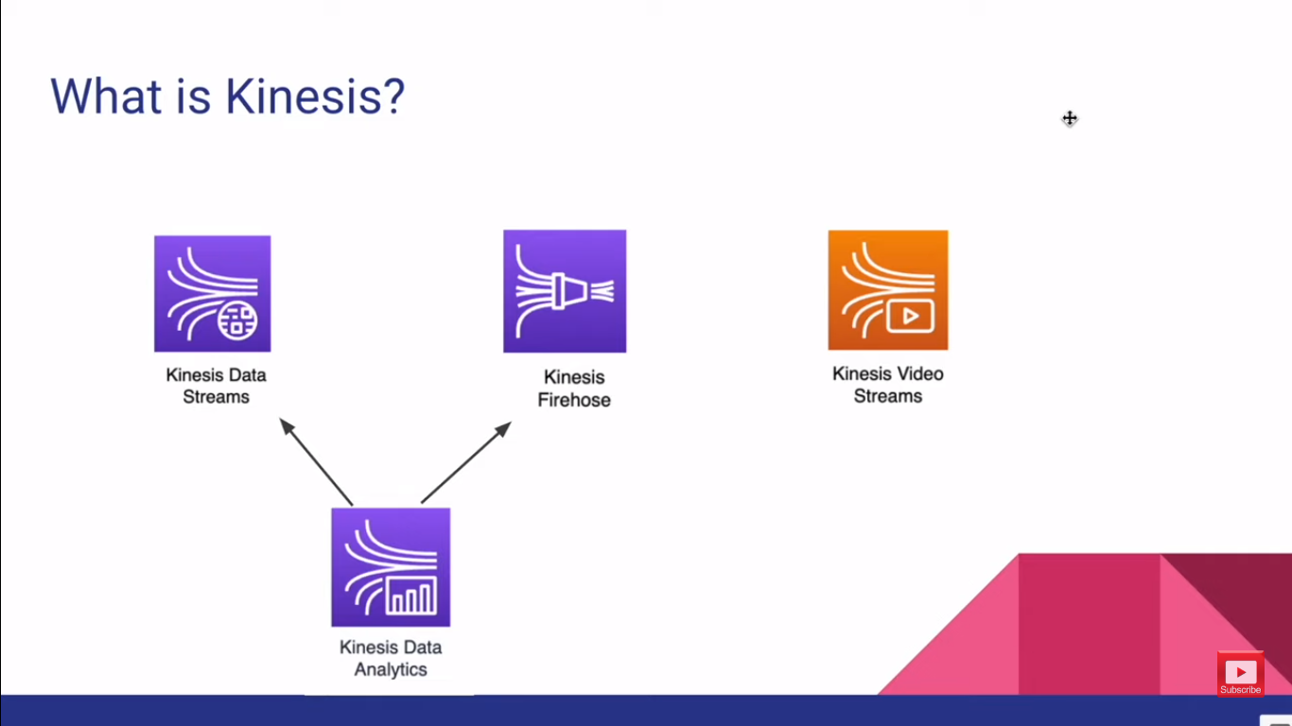
Notes:
so the next service in Kinesis
family is kinesis video streams now kinesi data streams and kinesis firehorse they can process data streams
what about video streams so if you have like thousands of cameras streaming videos
how can we process this data that's where the Kinesis video streams comes into picture Kinesis video streams as
the name implies it can ingest video streams and process these video streams
in real time you can use this service together with other AI services like AWS
comprehend to analyze the details in a picture frame so on and so forth so this
is really useful to analyze the video streams in real time now these are the main four services that is under Kinesis
all right

Slide 7
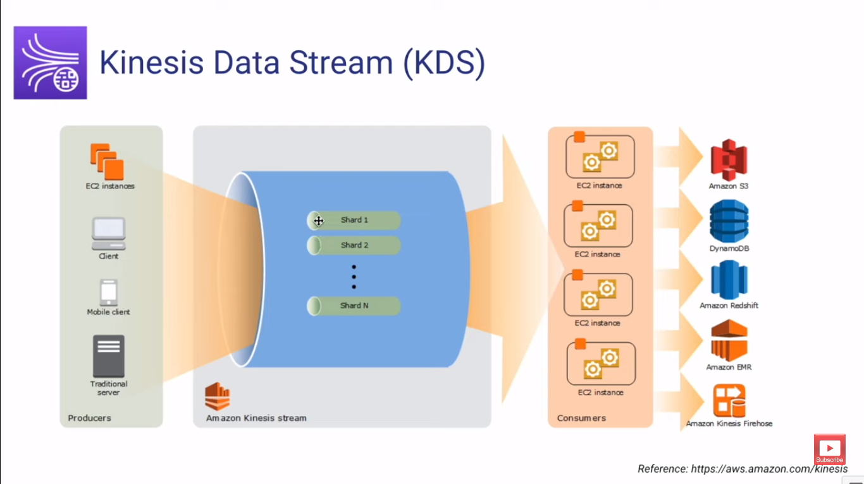
Notes:
now let's have a look at Kinesis data stream in detail
Understand Kinesis Data Stream(KDS)
all right so when you create a Kinesis data stream you have to Define how many
shards does that stream consist of now there are two modes that currency data
stream supports on demand mode and provision mode so if you are using on demand mode you
don't have to necessarily Define how many shards that your stream needs
but if you're using the provision mode you have to define the number of shards so what's so important about these
shards now charts is essentially determines the throughput that this stream can supports
now each shot can support 1000 records per second data ingestion or one
megabyte of data per second whichever comes first and in the other side the consumers can
read one of the shards maximum up to two megabyte per second or 5 reads per
second so the recommendation here is if you know exactly how much throughput
requirement would you need with your data stream then you can use the provision mode or else you probably be using the
on-demand mode but keep in mind there are different consideration for the on-demand mode which we are going to look at it little
later but right now I want you to know that a stream consist data stream is consist of
shards so when you have a Kinesis data stream then you can start producing data
through the Stream so here either you can have Kinesis producer applications running in ec2
machines or you can directly push data to the currency data stream using AWS sdks
and also you can set up Kinesis agents in your service it could be even on-prem
service that will push data to the kinesi Stream so once the data is ingested the shards
will retain that data by default up to 24 hours you can extend up to 7 Days
even up to one year but you have to pay for additional retention time
and then on the other side you can Define your consumers so you can write your consumer
application and this application can also be run in ec2 instances and when you process this data in the
Stream then you can send them into other targets like Amazon S3 you can persist that in
dynamodb so on and so forth now in addition to this you can Define
your serverless consumers as well now here you can use AWS Lambda
now this is a powerful integration we are going to learn a lot about AWS Lambda and Kinesis how they work
together now before diving into shards and producers consumers and AWS Lambda
let me give you a quick demo about how does Kinesis service looks like in AWS console

Slide 8
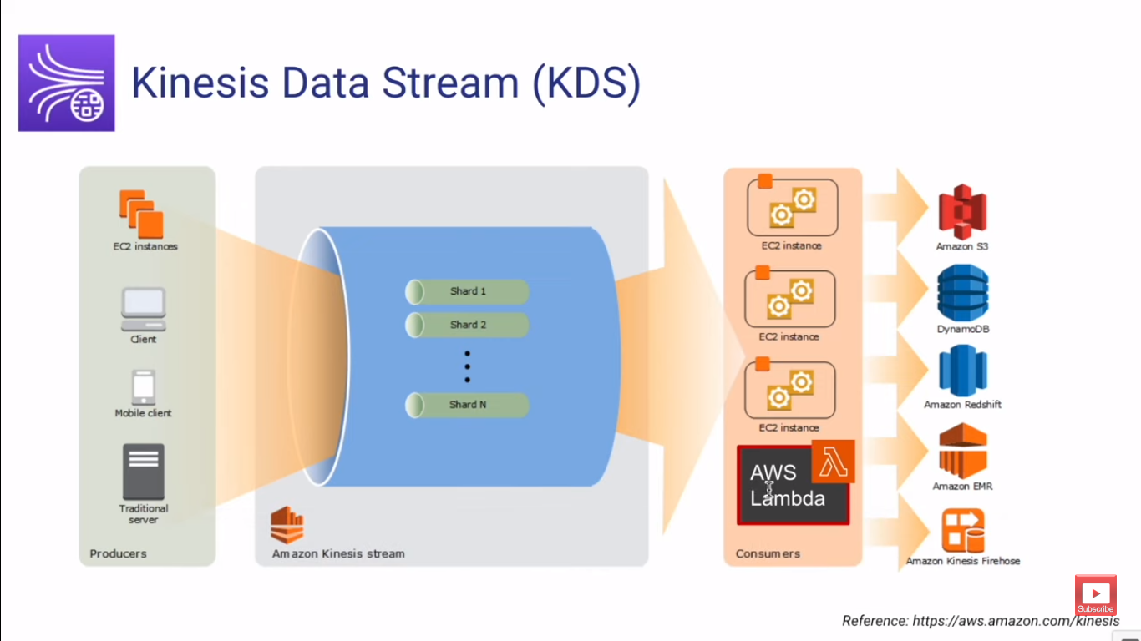

Slide 9
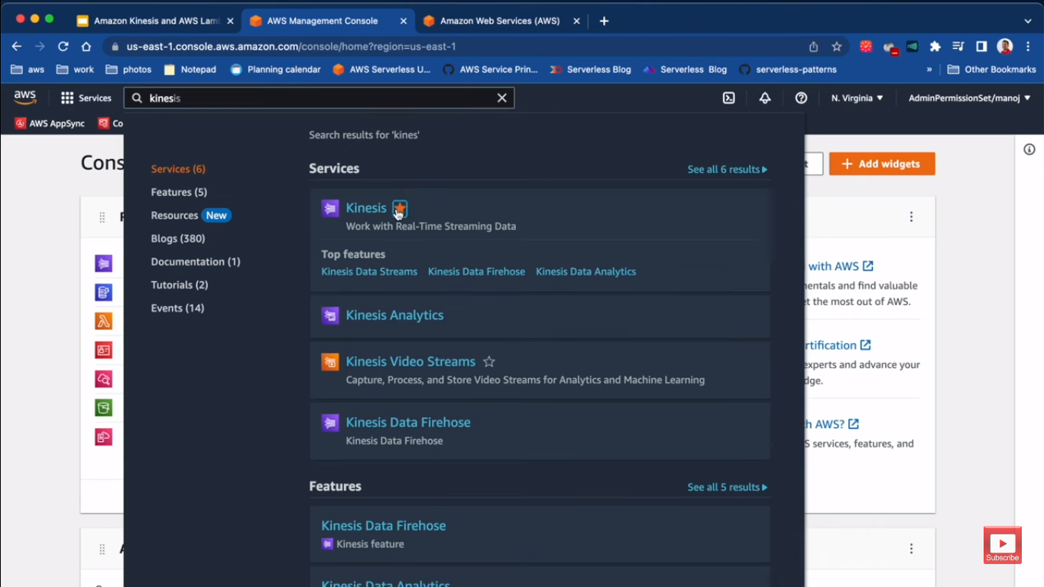

Slide 10
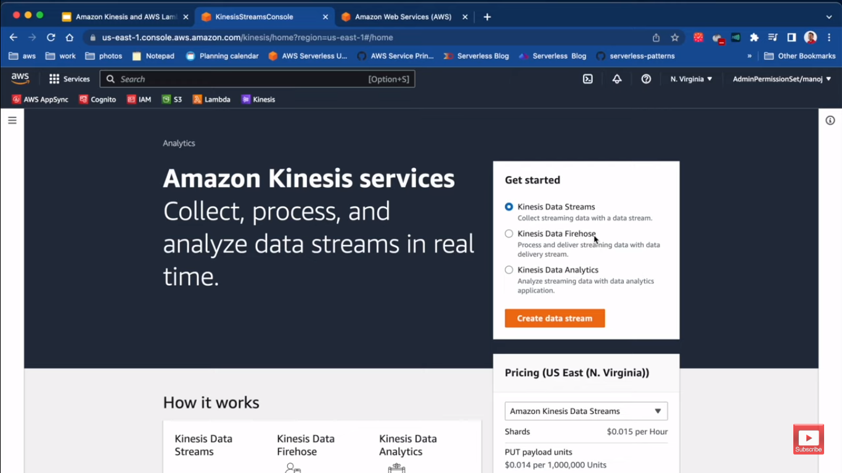
Notes:
so this is a service you can even bookmark it so here in the landing page I can start
creating a Kinesis data stream or Kinesis data fire host
or even kinetics data analytics application now here's a handy pricing calculator
you'll see how much you'll be charged for per chart per hour so here in this
North Virginia region it's 0.015 dollars power in addition to that when you are
ingesting data there's another additional charge to it now if we select Kinesis fire hose
now it's only charged for the data ingestion see there's no any hourly cost
and if you do not ingest any data in a month you won't be charged so that's a
truly a serverless service but here I will select message data stream and go ahead

Slide 11
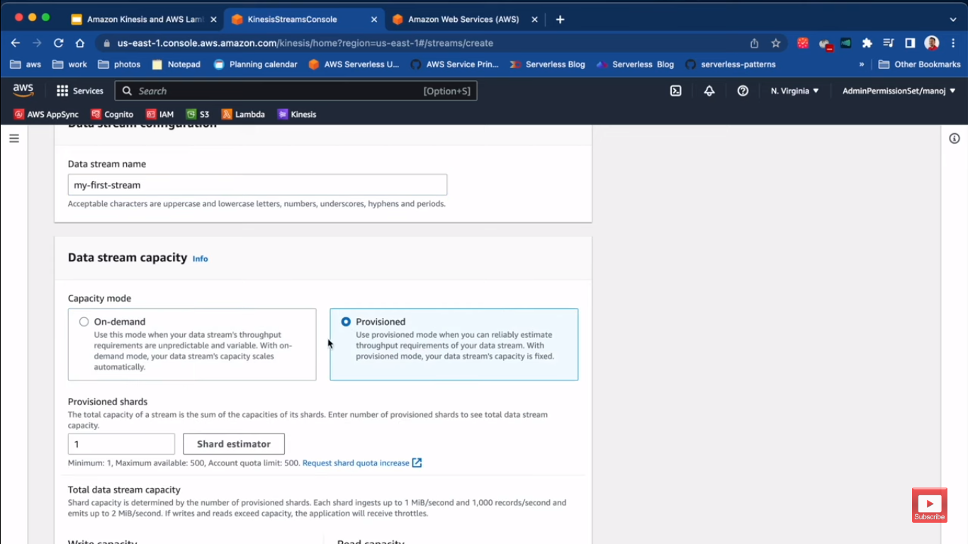
Notes:
I will select message data stream and go ahead and click create data stream
my first data stream to name and then I'm supposed to select the
capacity mode is it on demand or provision so here for this demo I'll select permission
then I have to Define how many shards do I need in my stream I'll keep it just one shard
you can create up to 500 shards per stream but this is soft limit you can always contact AWS and increase the
quots then to give you some information what's the right capacity and what's the rate capacity like I mentioned if you have
just one shard your entire stream throughput is one megabyte per second and thousand records
per second so if I make it 2 then it become 2
megabytes per second and two thousand records per second you get the idea right now keep it back to one
that's all and I'll go ahead and create the Stream so it will take few minutes

Slide 12
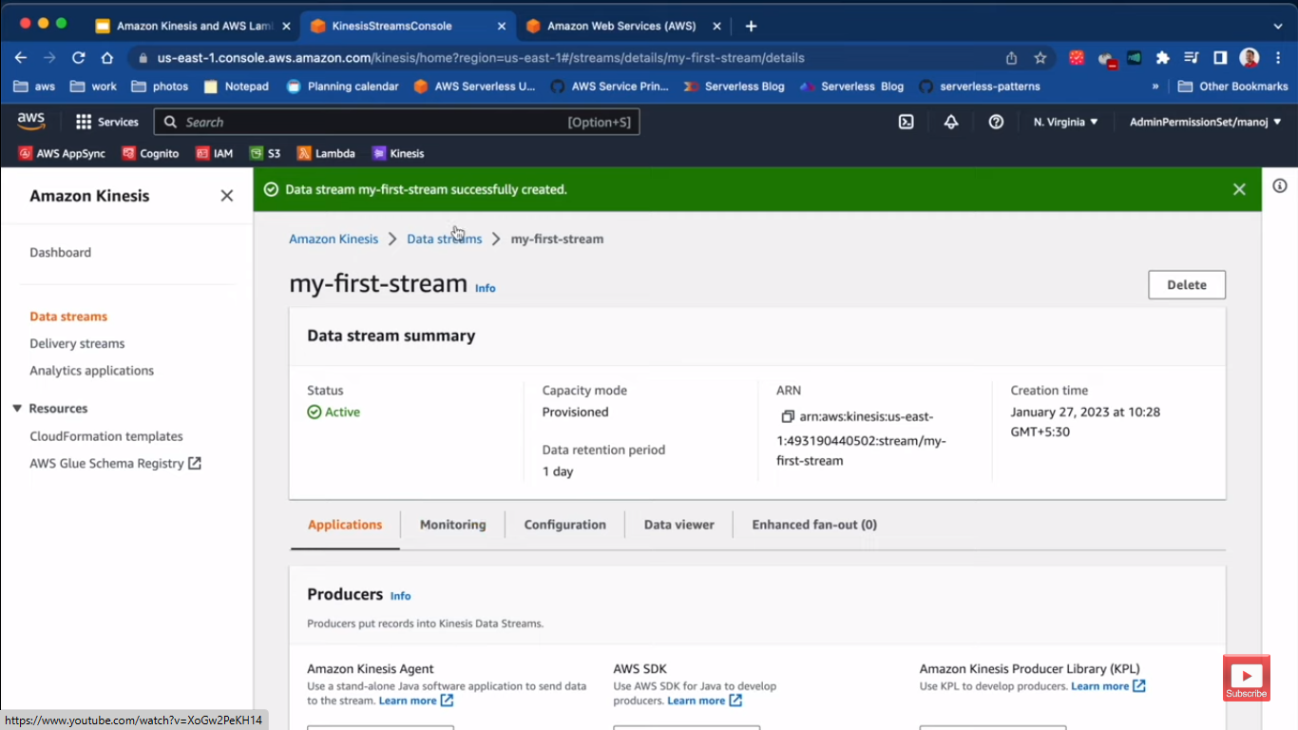
Notes:
here we go now it's available and now that I have a data stream I can
start producing data to it or ingesting data to it so here in

Slide 13
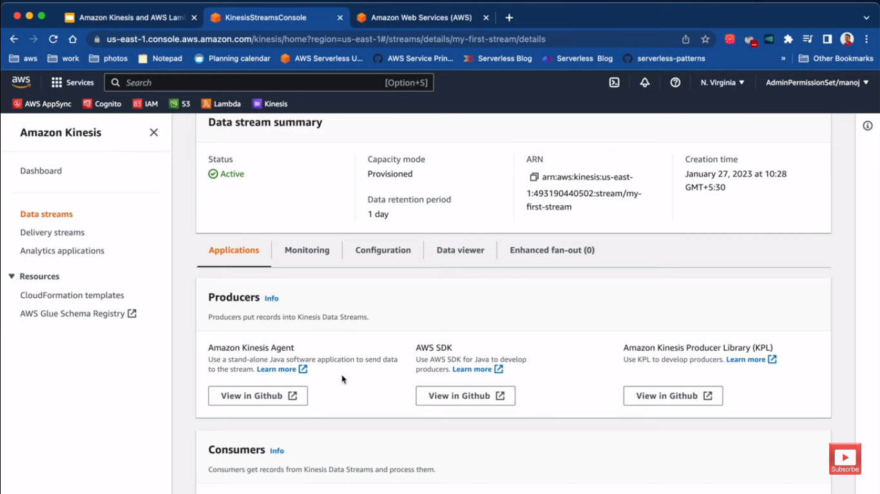
Notes:
this section you have the
producer section here I can use Kinesis agent I can
install this in a server so this is a Java application and then start sending
data to the Stream I can also use AWS SDK
and I can also use another Library which is specific for Kinesis which is called
Kinesis producer Library now this has some additional capabilities

Slide 14
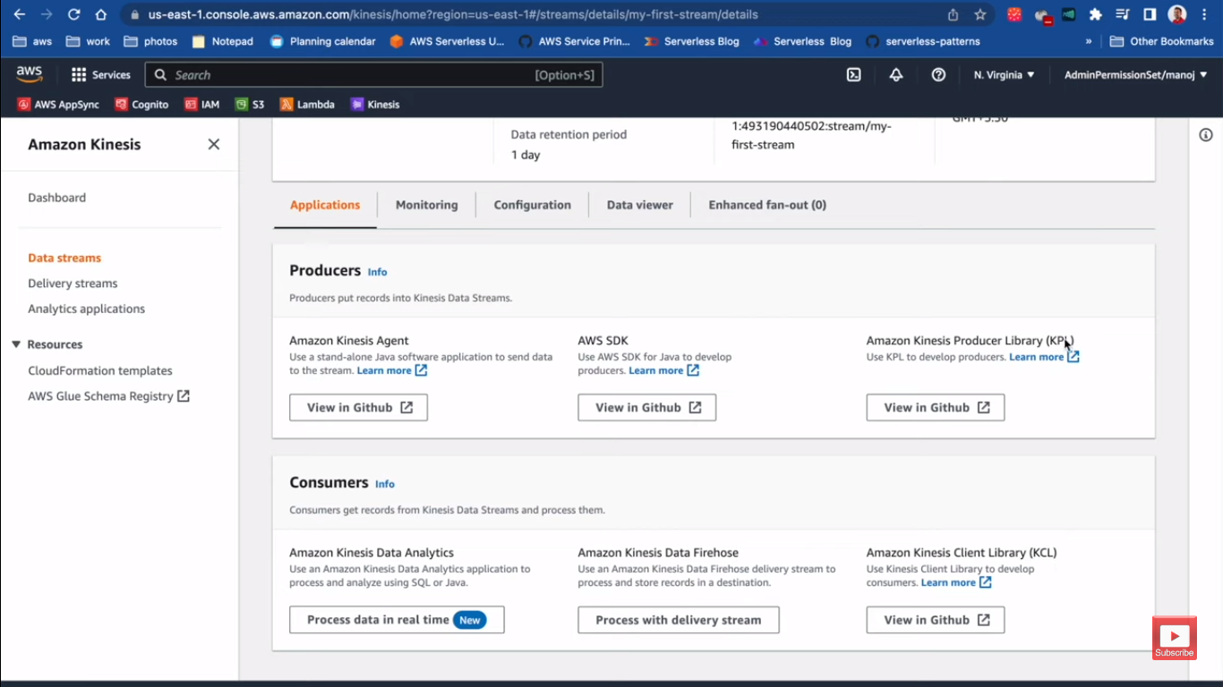
Notes:
we have the consumers so once you have data in the Stream
you can connect the Kinesis data analytics application or else you can push that data to a Kinesis data fire
hose so you can batch and put them into different targets and you can also use Kinesis client
Library the KCl so if you have used kpl to produce the data the KCl can be
easily used to consume that data as well but here AWS Lambda is not particularly
mentioned but you can go to AWS Lambda service which I have already bookmarked
or you can just search for it Lambda

Slide 15
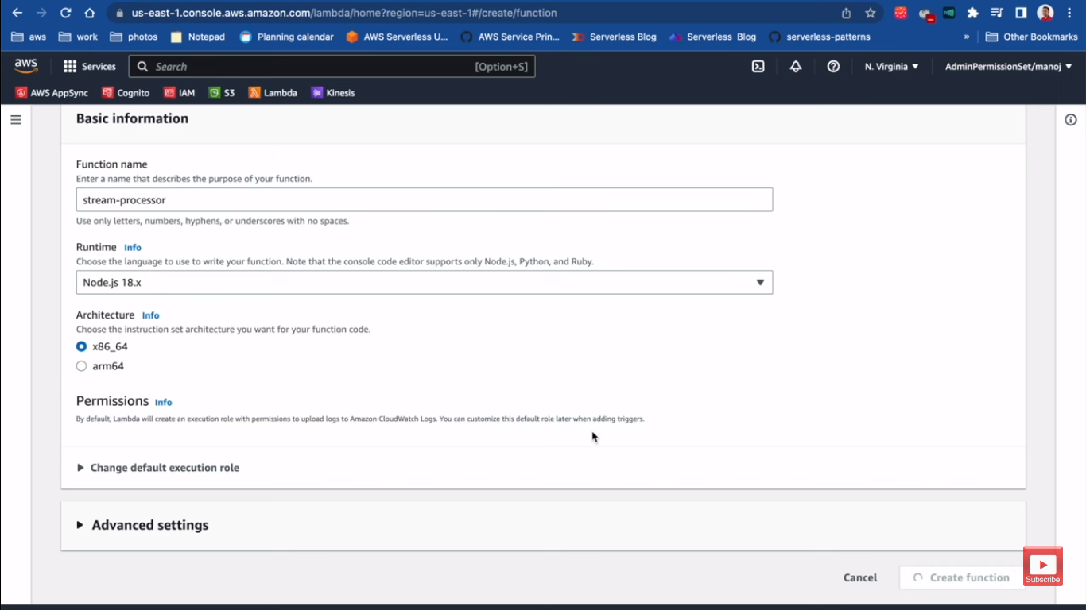
Notes:
open it a new tab now go ahead and create a function I call it stream processor
and then I'll go ahead and create the function

Slide 16
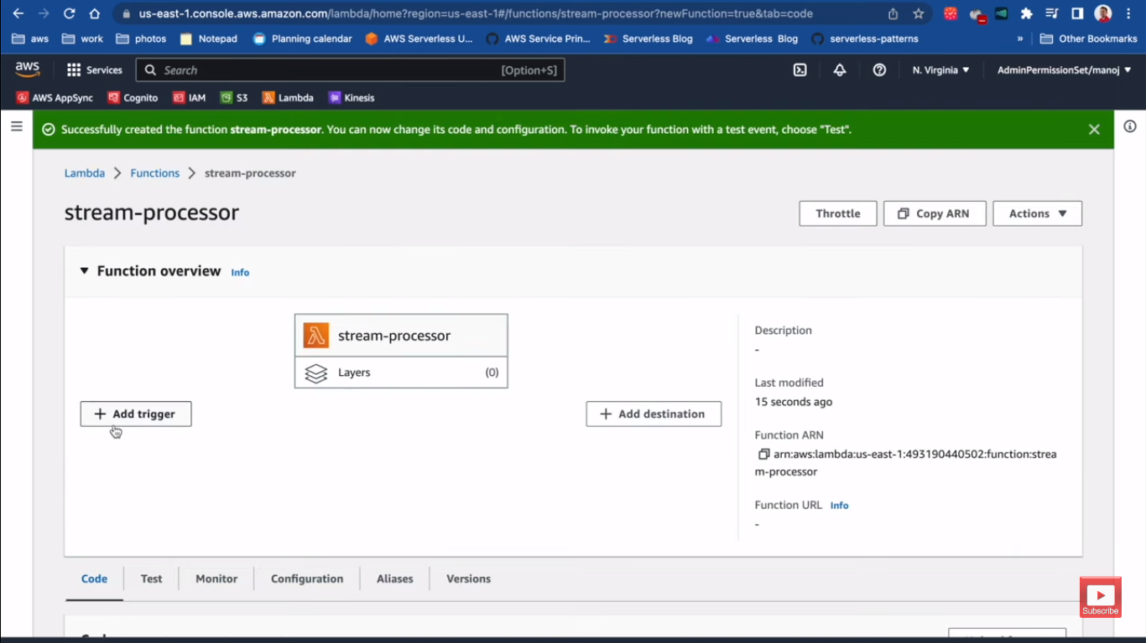
Notes:
here now from the Lambda console itself I can
attach the triggers that trigger this Lambda function so if you click add trigger

Slide 17
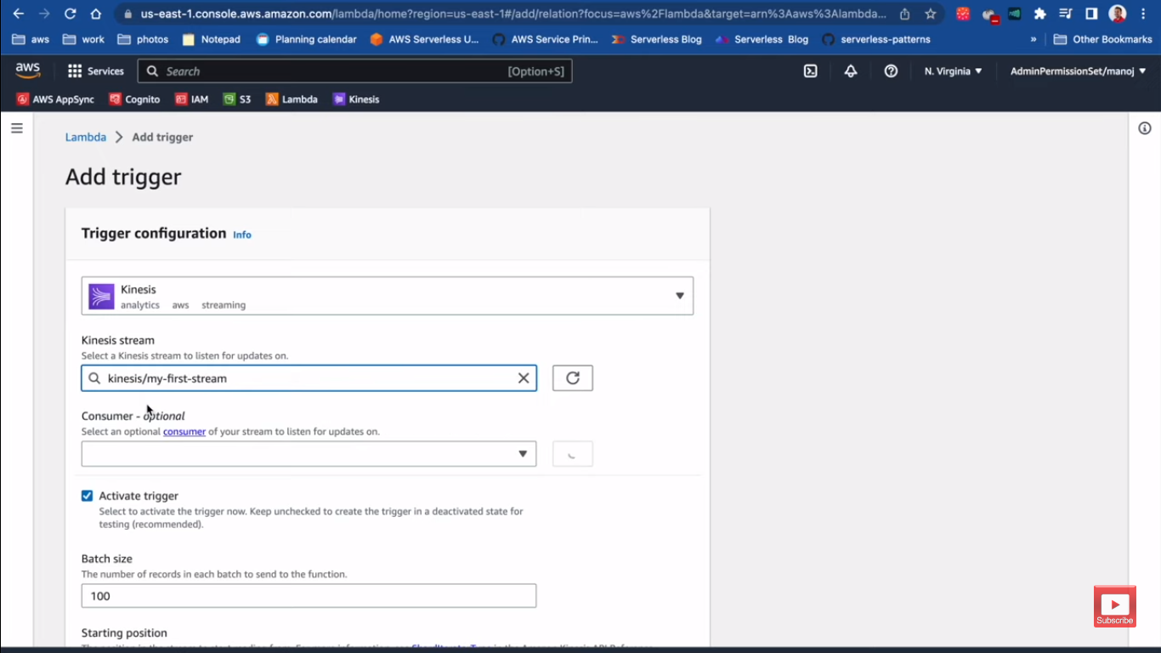
Notes:
and I can select a source in this case I can search for kinesis
here we go and then I can search for the Kinesis data stream in this region which is my
first stream here I can enable the trigger and there
are a bunch of configuration like the batch size starting position batch
window and additional settings what happens if something got failed free try
tumbling window so on and so forth we are going to learn all about that in
this course but right now I'll just go ahead and click add
and here when I click add I get an error it says please ensure the role can
perform git records get Shard iterator and few other actions related to the Stream
now this is essentially as with any other thing in AWS in order to communicate between two Services the
proper permission should be declared now how am I going to do that
so in this case the Lambda is going to pull the data from the stream so we have
to associate this permission using an IAM role to this Lambda function

Slide 18
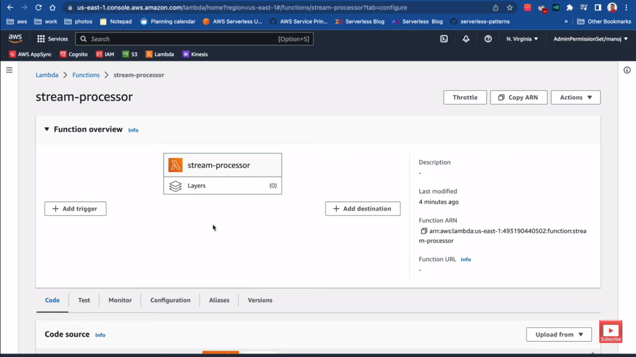
Notes:
now how am I going to do that
so in this case the Lambda is going to pull the data from the stream so we have
to associate this permission using an IAM role to this Lambda function
now IM is the service that we can grant permission to AWS Services AWS users so
on and so forth in AWS ecosystem so here right now if we go to the
configuration section of my Lambda function you can see there's the permission tab
and there's automatically a im role created for this Lambda function
now this IM role defines the permissions that this Lambda function has so I can
click into it it will open the IM console and the role section for this IM

Slide 19
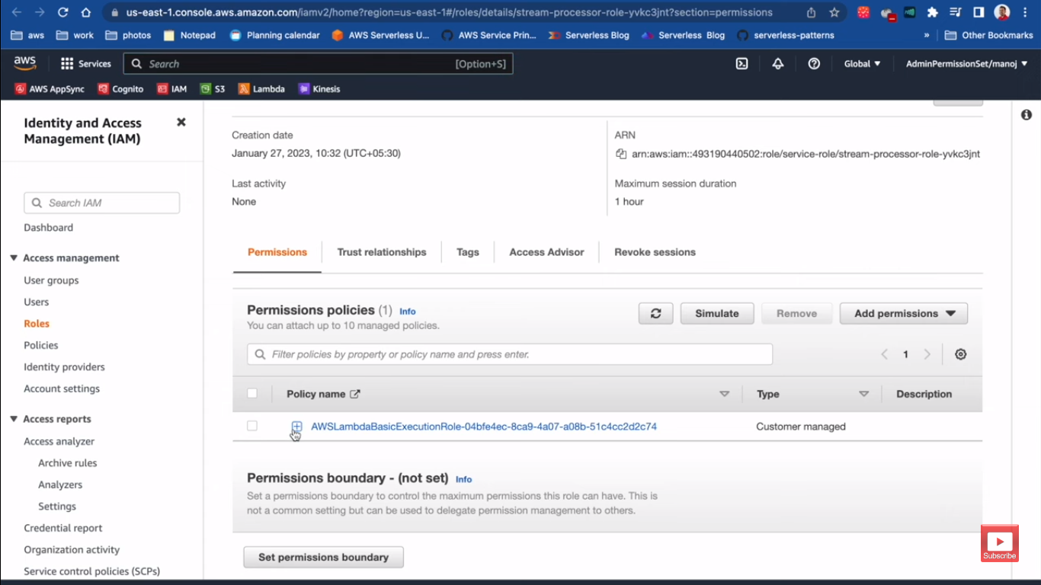
Notes:
it it will open the IM console and the role section for this IM
role is open and here under the permissions so this is the current permission that Lambda
automatically has added upon creation so it's only allowing it to log data to
Cloud watch it doesn't have anything related to thinances so what we can do here
is to add some additional permission so I can click add permission to this role
attach policies permission policy let's search for kinesis
now here we have a bunch of managed IM policies now these are managed by AWS you can create your own policy as well
but for now I will give MSN currencies read only access
so I'll attach this policy to this particular role so then this role will have that permission if you scroll down
you can see here now this role is attached to the Lambda functions meaning that our Lambda function also has the
read only permission for any Guinness stream in this account you can
be as granular as if you want with IM permissions but this is just a small demo so I'll go

Slide 20
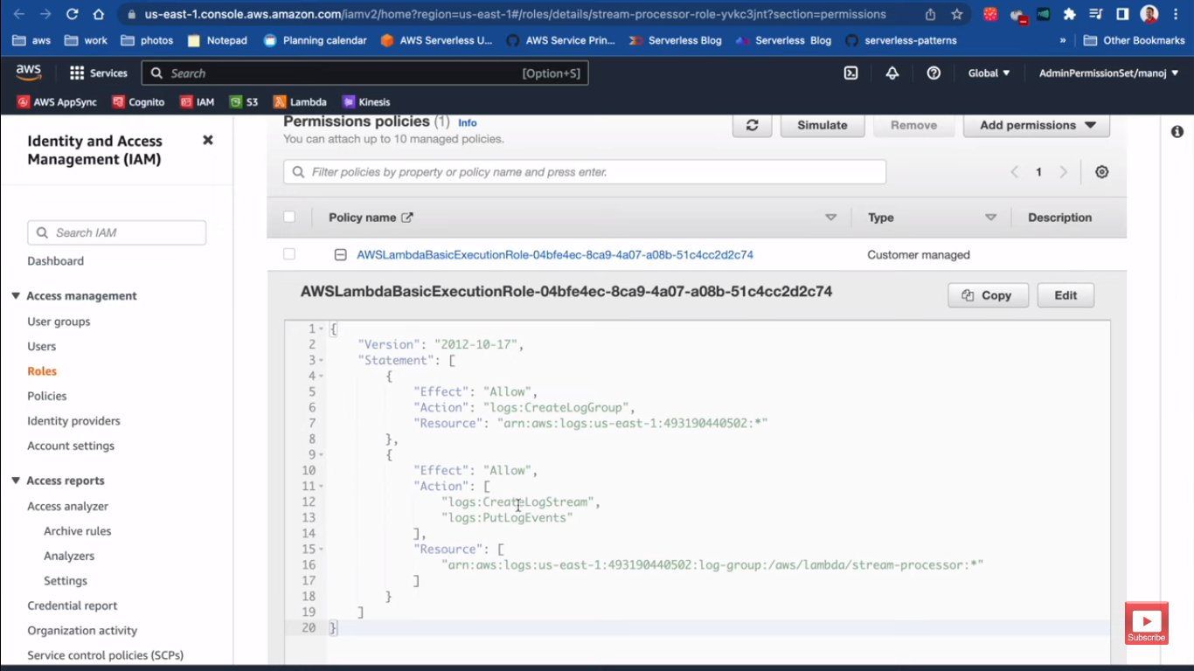
Notes:
it it will open the IM console and the role section for this IM
role is open and here under the permissions so this is the current permission that Lambda
automatically has added upon creation so it's only allowing it to log data to
Cloud watch it doesn't have anything related to thinances so what we can do here
is to add some additional permission so I can click add permission to this role
attach policies permission policy let's search for kinesis
now here we have a bunch of managed IM policies now these are managed by AWS you can create your own policy as well
but for now I will give MSN currencies read only access
so I'll attach this policy to this particular role so then this role will have that permission if you scroll down
you can see here now this role is attached to the Lambda functions meaning that our Lambda function also has the
read only permission for any Guinness stream in this account you can
be as granular as if you want with IM permissions but this is just a small demo so I'll go

Slide 21
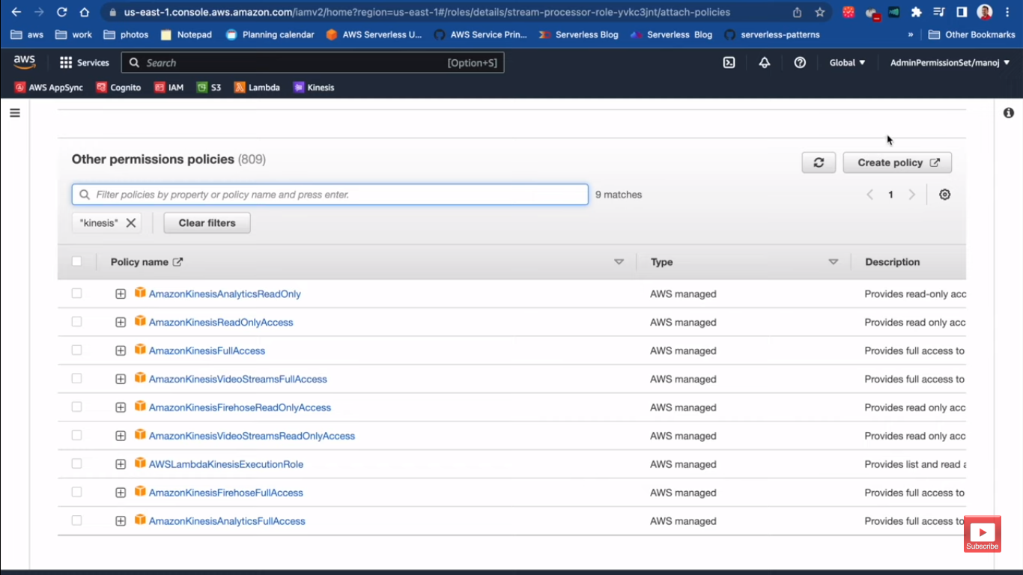
Notes:
it it will open the IM console and the role section for this IM
role is open and here under the permissions so this is the current permission that Lambda
automatically has added upon creation so it's only allowing it to log data to
Cloud watch it doesn't have anything related to thinances so what we can do here
is to add some additional permission so I can click add permission to this role
attach policies permission policy let's search for kinesis
now here we have a bunch of managed IM policies now these are managed by AWS you can create your own policy as well
but for now I will give amazon kinesis read only access
so I'll attach this policy to this particular role so then this role will have that permission if you scroll down
you can see here now this role is attached to the Lambda functions meaning that our Lambda function also has the
read only permission for any Guinness stream in this account you can
be as granular as if you want with IM permissions but this is just a small demo so I'll go

Slide 22
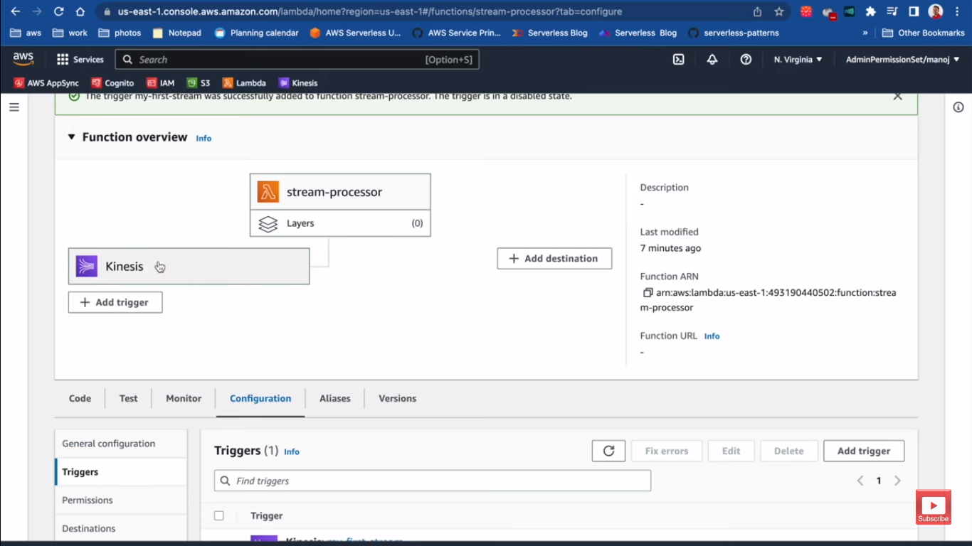
Notes:
so I'll go
ahead and add the trigger again and let's see if this time I can create this
trigger correctly select the service and go ahead and click it
there we go now it's properly created in the UI itself you can see our Lambda
function is triggered by this Kinesis data stream

Slide 23
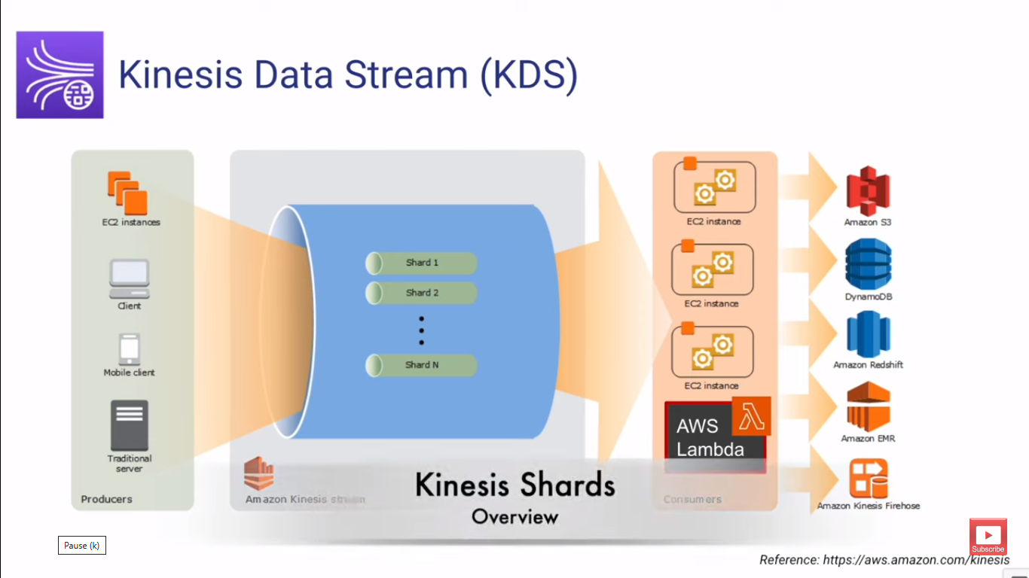
Notes:
now this is just the overview we have to go in detail how does this integration
happen and what are the consideration and also we will build a stream processing
application with Kinesis and AWS Lambda so now that you have some understanding
Understand Shard
about how Kinesis looks like in AWS console let's understand a little bit
more about shards because shards is the core component of
Kinesis data stream

Slide 24
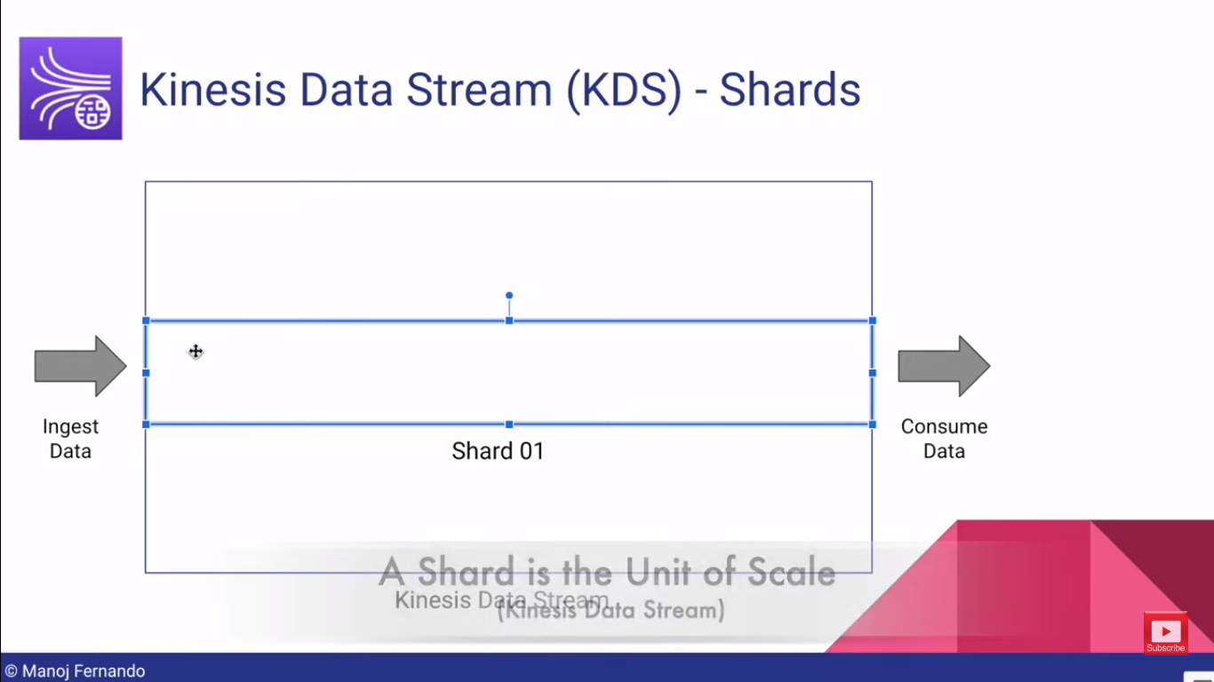
Notes:
Kinesis data stream so if you look at the Kinesis data stream you will ingest data and then you
will consume data but in order to ingest data the stream has to include one or
more shards as you remember you can go up to 500 shards per stream depending upon the
region that you are in and you can also extend it by pressing a support request to AWS
so Shard essentially is the unit of scale in Kinesis data stream so if you want more throughput you will
increase shards and if you want to decrease the throughput of the stream you can reduce the shards by merging
multiple shots together however if you're using the on demand mode then this is handled for you
automatically so we already discussed you can go up to 500 or 200 charts per stream based upon the region that you are in

Slide 25
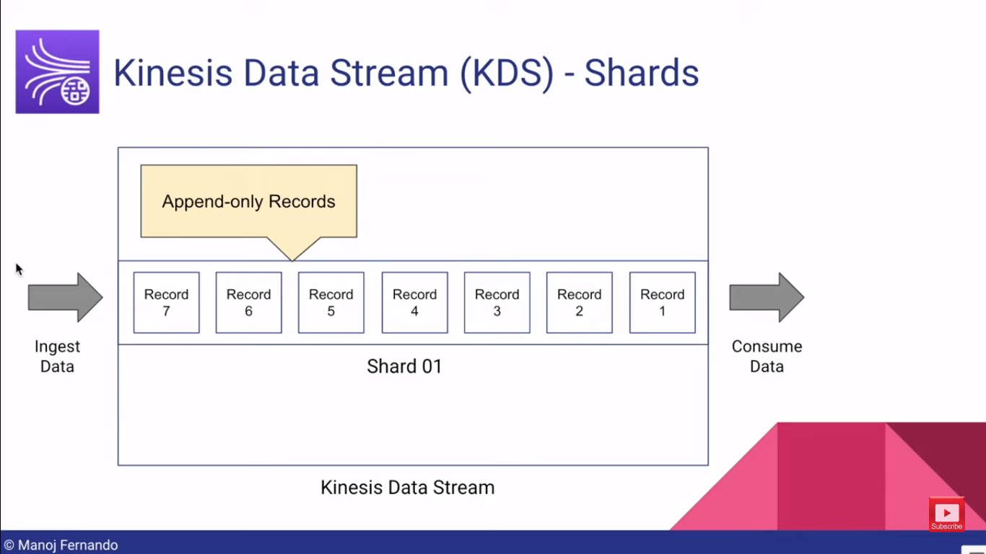
Notes:
when you have a Shard you can ingest
data records into that shards here you can use AWS SDK or produce
application to ingest records into the stream so here we have record one two
three four five six seven eight so on and so forth now here are few characteristics of these records now
these records that you ingest into a Shard are append only meaning that once you have the record in
the Stream in the chart you can't delete it unless of course the retention period is expired and the keynesis itself

Slide 26
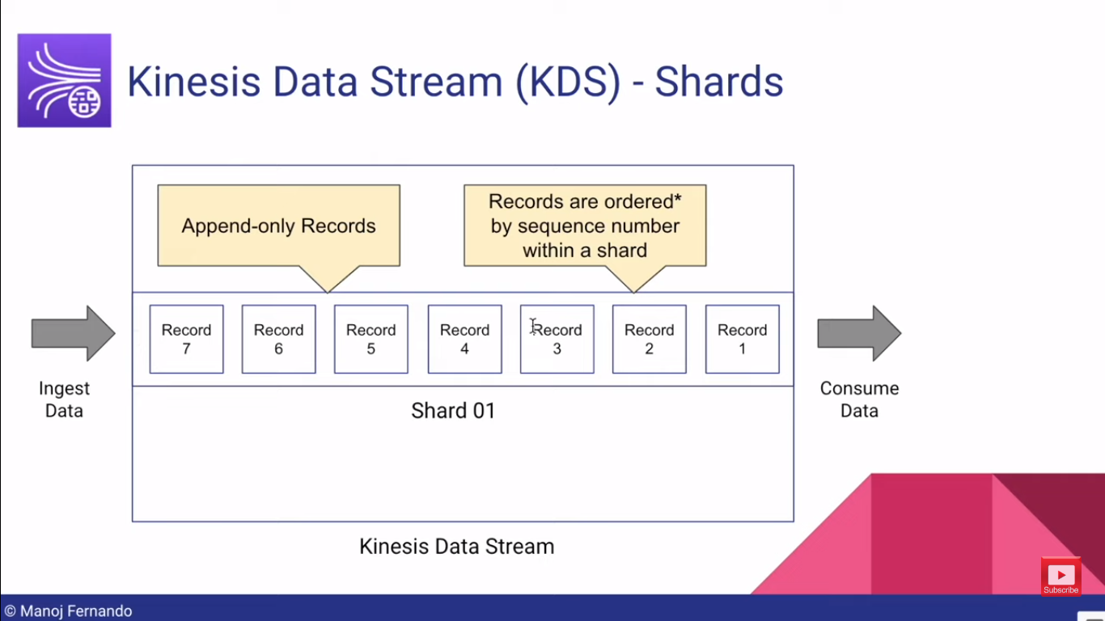
Notes:
now
these records that you ingest into a Shard are append only meaning that once you have the record in
the Stream in the chart you can't delete it unless of course the retention period is expired and the keynesis itself
remove that record do you remember the default retention period is 24 hours you can extend up to
one year so when consumers are consuming these records even after one consumer consume
a particular record it is still not deleted so multiple consumers can consume the
same data record now unlike in sqsq which is the manage queue service in AWS
where the record is consumed by a consumer then it is removed in Kinesis
it's not the case one record can be consumed by multiple consumers we will compare and contrast
Kinesis with other services later in this course but for now remember that the records in a Kinesis data stream
inside a shard can be consumed by multiple consumers and the other thing is these records are ordered in the
sequence that they are added to the shard and when you are ingesting record to Kinesis data stream into a Shard you
have to specify two attributes one is partition key and the other one is
sequence number now when you're adding record to the Kinesis data stream each record will automatically be assign a
sequence number now sequence number automatically increases according to the arrival time
but it's important to note that if we consider a Shard the records are ordered
by the sequence number unless of course you are not using this
property called Kinesis parallelization factor with AWS Lambda now this is a little bit of advanced topic we are
going to learn about indiness course as well but in general if you put records into Kinesis stream
they are ordered in the way that they arrived and this order is guaranteed within a
shard now when you consider a record there are two properties
first one is the partition key and the other one is sequence number you already
heard about the sequence number these automatically generated at the time they are added to the stream by Kinesis you

Slide 27
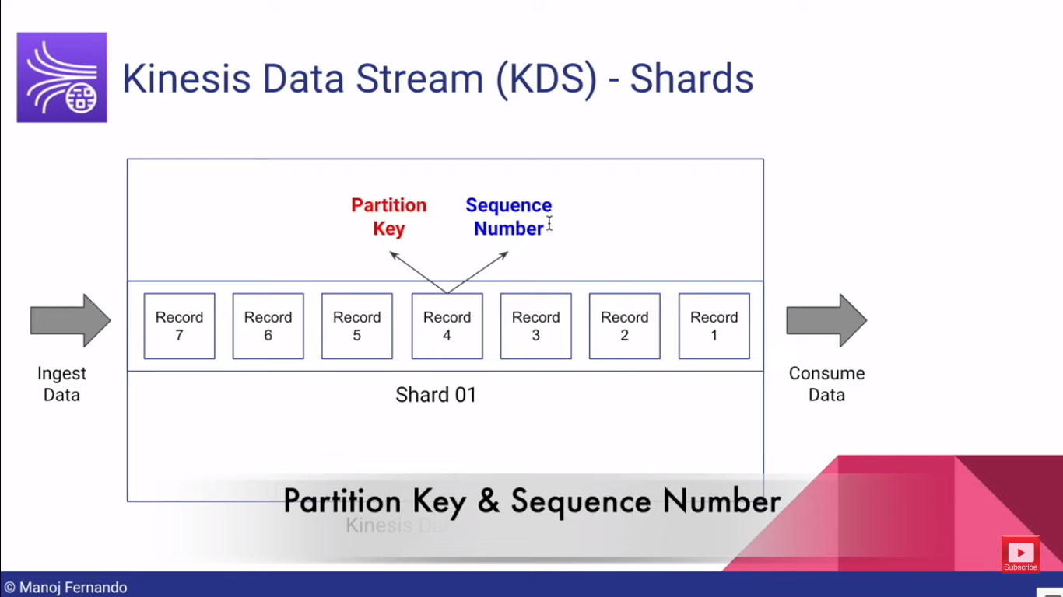
Notes:
general if you put records into Kinesis stream
they are ordered in the way that they arrived and this order is guaranteed within a
shard now when you consider a record there are two properties
first one is the partition key and the other one is sequence number you already
heard about the sequence number these automatically generated at the time they are added to the stream by Kinesis you
can also Define your own sequence number if you will but they automatically generated but the partition key is something that
you need to associate with each and every record that you are ingesting to the Stream
now this is a very valuable property why is that because partition key is the value that
determines The Shard

Slide 28
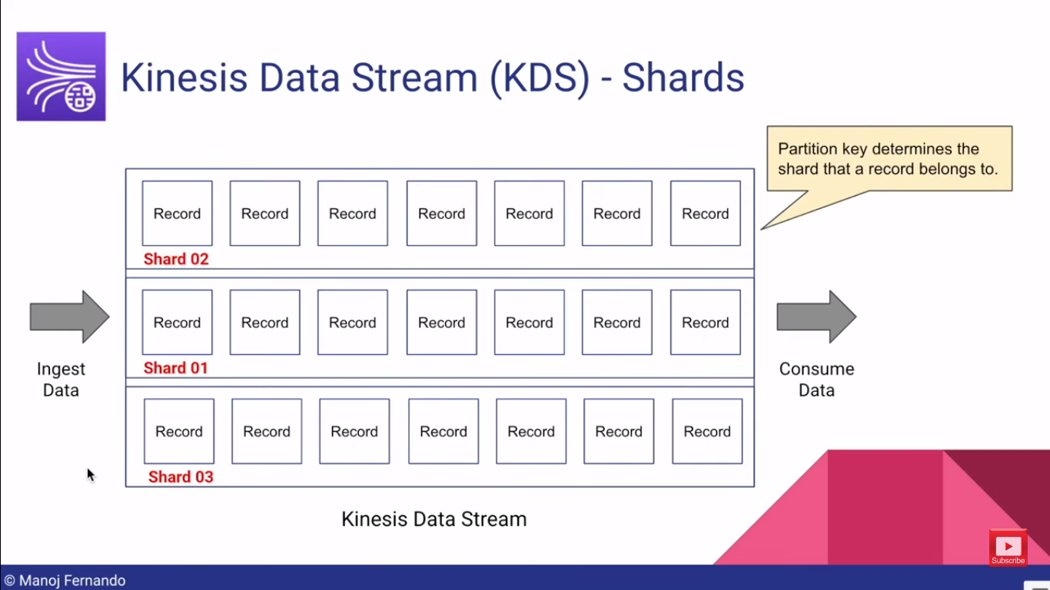
Notes:
but however if you have multiple shards just like in this example
when you are ingesting the data the partition key determines which shards the data is ingested to
but however keep in mind that there could be records belongs to different partition key landed onto the same shard
how is that possible this is because Kinesis uses a hash function
and use this partition key as an argument to this hash function and identify what Shard these records
belongs to so there could be occasions two partition key has the same Shard
number now for example let's imagine that we are ingesting record and this records include partition key
from partition key one two three four five six seven eight one two eight but
our stream only has three shards so it's obvious that multiple partition key could land it to the same shard

